Slide 1
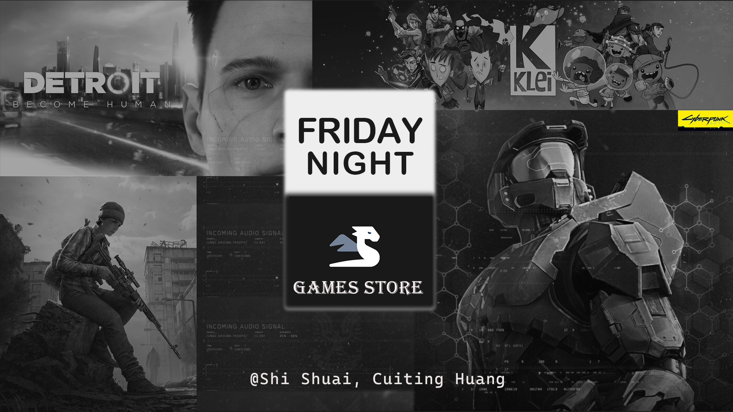

Slide 2
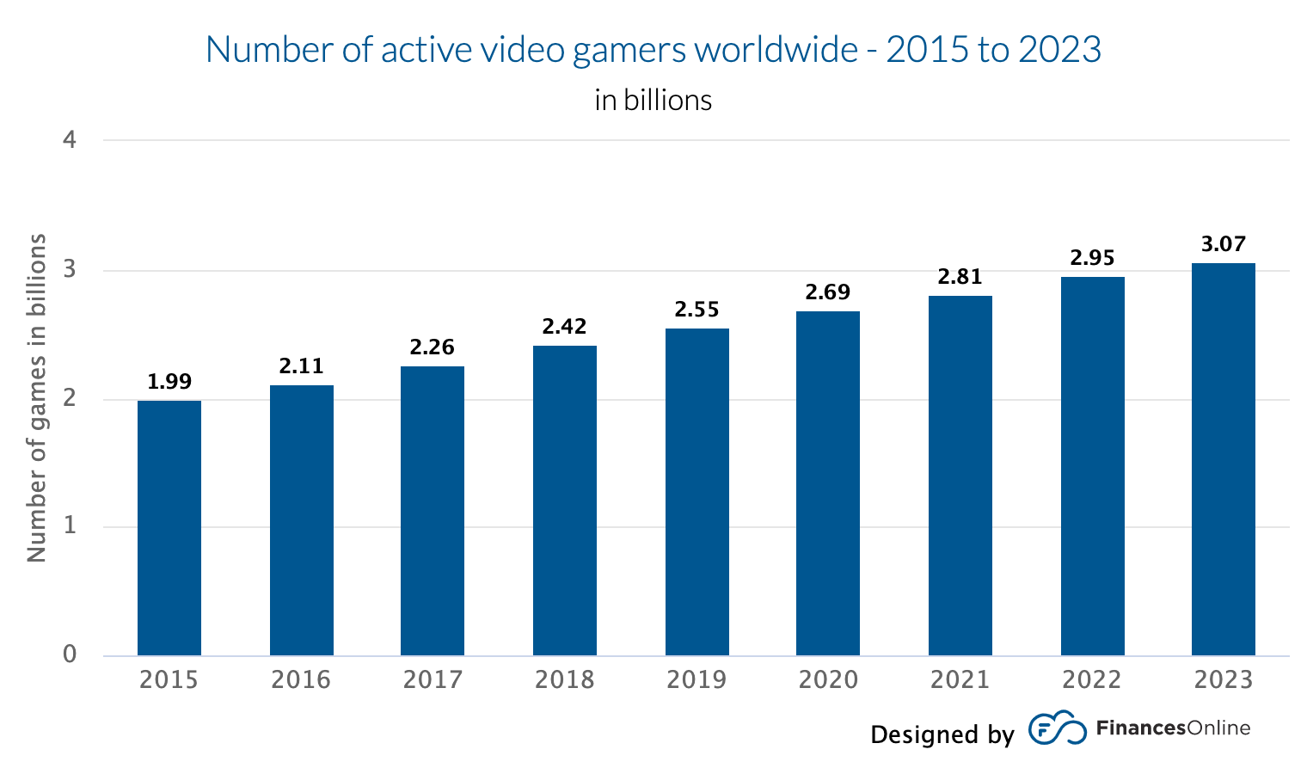
Introduction
Problems of current online game platforms
Too many : Xbox, Origin, GOG…
High prices
Solution 👉 Friday Night one-stop platform
Collection of popular games
Affordable price
Players community
https://financesonline.com/number-of-gamers-worldwide/

Slide 3
Architecture & Technology Stack
Architecture - MVC
Technology stack – MERN
Frontend
API
Backend Express
https://en.wikipedia.org/wiki/Model%E2%80%93view%E2%80%93controller

Slide 4
Data Model
PRODUCTS
ORDERS
{
_id: ObjectId(“PRODUCT1”),
user: ObjectId(“USER1”),
name: “DayZ”,
cover: “cover.jpg”,
tag: “Zombies”,
releasedate: “13 Dec, 2018”,
category: “Action”,
......
price: 71.08,
countInStock: 99,
rating: 3.9,
numReviews: 10,
reviews: [
{
user: ObjectId(“USER1”),
username: “Admin”,
rating: 4,
review: “Awesome!”
}
]
}
{
_id: ObjectId(“ORDER1”),
user: ObjectId(“USER1”),
orderItems: [
{
product: ObjectId(“PRODUCT1”),
name: “DayZ”,
qty: 1,
cover: ”cover.jpg”,
price: 71.08
}
],
totalPrice: 79.61,
isPaid: true,
paidAt: “29 Apr, 2022”
}
USERS
{
_id: ObjectId(“USER1”),
username: “Admin”,
email: “admin@test.com”,
password: “123456”,
isAdmin: true
}
REVIEWS
{
_id: ObjectId(“REVIEW1”),
user: ObjectId(“USER1”),
product: ObjectId(“PRODUCT1”),
rating: 4,
review: “Awesome!”
}

Slide 5
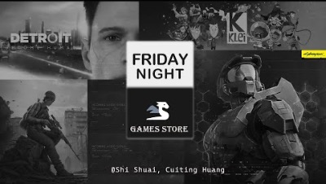
Demo

Slide 6
Reflection
We are proud of …
UI design
React Helmet
React Bootstrap - Tabs
Redux
Challenging part
Redux test

Slide 7
What would you do next
if you would continue this project?
Implement administrator functionality
Optimize product images storage
Improve search functionality
Implement pagination

